Slide 1
DC Motor CHARACTERISTICS

Slide 2
MOTOR CHARACTERISTICS
Torque and armature current : T_{a} / I_{a} – Electrical characteristic
Speed and armature current: N/ I_{a}
Speed and torque: N / T_{a} - Mechanical characteristic

Slide 3
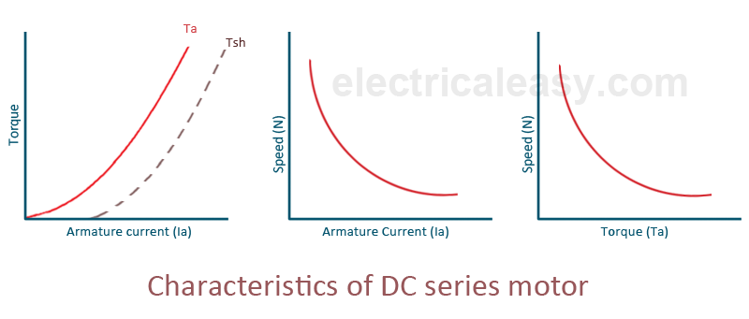
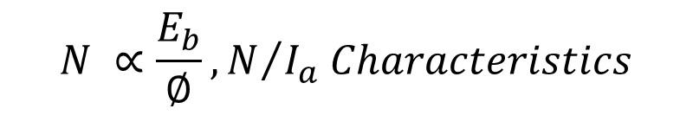

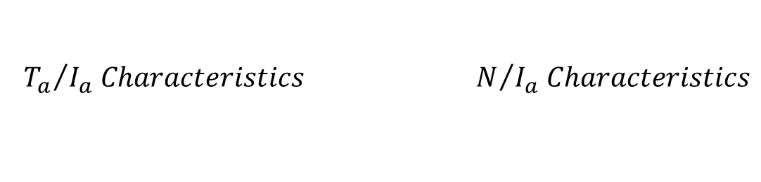
CHARACTERISTICS OF DC SERIES MOTOR
$$T_{a}∝ ∅ I_{a} and ∴T_{a}∝ {I_{a}}^{2}$$
$$N ∝\frac{E_{b}}{∅}, N/{I_{a} Characteristics}$$
$${{T_{a}}/{I_{a} Characteristics} N}/{I_{a} Characteristics}$$

Slide 4
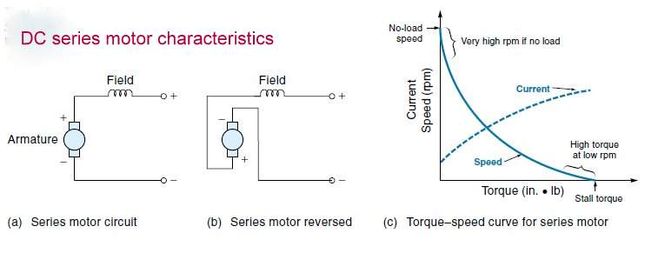
CHARACTERISTICS OF DC SERIES MOTOR
$$N/{I_{a} −Mechanical Characteristics}$$

Slide 5
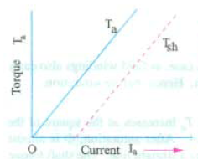





CHARACTERISTICS OF DC SHUNT MOTOR
$$T_{a}/I_{a}characteristic$$
$$N/I_{a}characteristic$$
$${N/T}_{a}characteristic$$
$$T_{a}∝I_{a}$$
$$N∝E_{b}$$

Slide 6
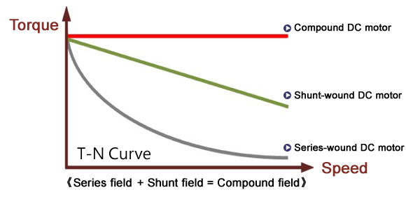
COMPOUND MOTORS
Cumulative compound Motors Differential – Compounded Motor

Slide 7
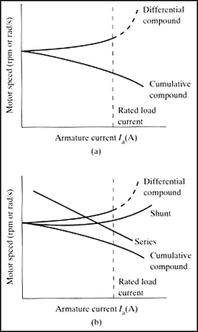

Slide 8
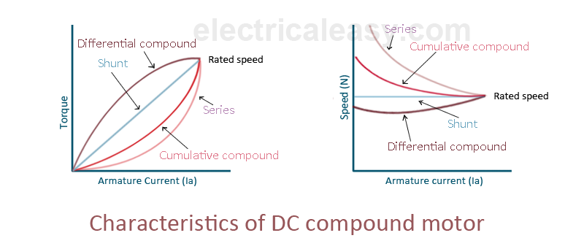
CHARACTERISTICS OF COMPOUND MOTOR

Slide 9
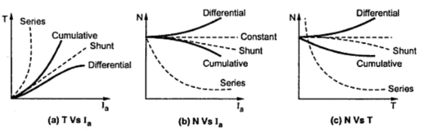
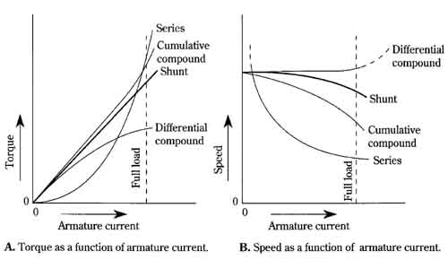

Slide 10
Summary of Applications
Type of Motor | characteristics | Applications
Shunt | Approximately constant Adjustable speed Medium starting torque(upto 1.5 F.L. torque) | For driving constant speed line shafting Lathes Centrifugal pumps Blowers and fans Reciprocating pumps
Series | Variable speed Adjustable varying speed High starting torque | Traction work – electric locomotives Rapid transit systems Trolley, cars etc. Cranes and hoists conveyors
Cumulative compound | Variable speed Adjustable varying speed High starting torque | For high intermittent torque loads Shears and punches Elevators Conveyors Heavy planers Rolling mills; ice machines; printing presses; air compressors

Slide 11
POWER FLOW DIAGRAM

Slide 12
Series Motor Power Flow Diagram
P_{cf}=i_{a}²R_{f}
P_{μ}
P_{in}= V_{T}i_{L}
P_{m}
P_{out}
P_{ca}=i_{a}²R_{a}
P_{μ} is normally given
P_{in} = P_{out} + total losses
Where,
P_{ca} =armature copper loss
P_{cf} =field copper loss
Pμ=stray, mech etc
P_{m}= E_{a} i_{a}

Slide 13
Shunt Motor (power flow diagram)
P_{cf}=i_{f}²R_{f}
P_{μ}
P_{in}=V_{T}i_{L}
P_{m}
P_{out}
P_{ca}=i_{a}²R_{a}
P_{μ} is normally given
P_{in} = P_{out} + total losses
Where,
P_{ca} =armature copper loss
P_{cf} =field copper loss
Pμ=stray, mech etc
P_{m}= E_{a} i_{a}

Slide 14
Compound motor (power flow diagram)
P_{ca}=i_{a}²R_{a}
P_{cf2}=i_{a}²R_{f2}
P_{μ}
P_{in}=V_{T}i_{L}
P_{m}
P_{out}
P_{cf1}=i_{f}²R_{f1}
P_{μ} is normally given
P_{in} = P_{out} + total losses
Where,
P_{ca} =armature copper loss
P_{cf} =field copper loss
Pμ=stray, mech etc
P_{m}= E_{a} i_{a}

Slide 15
Thank you

Slide 17
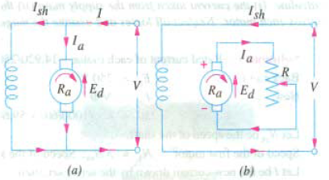
DYNAMIC BRAKING

Slide 18
DYNAMIC BRAKING

